Slide 1
Digital Interventions to Reduce Distress Among Frontline Health Care
Providers: Analysis of Self-Perceived Stress
Binh Nguyen*, Andrei Torres, Alice Rueda, Walter Sim, Douglas M Campbell, Wendy Lou, Bill Kapralos, Lindsay Beavers, Adam Dubrowski, Venkat Bhat, and Sridhar Krishnan

Slide 2
Introduction
Healthcare workers have reported experiencing moral distress due to the constraints of COVID-19 Pandemic

Slide 3
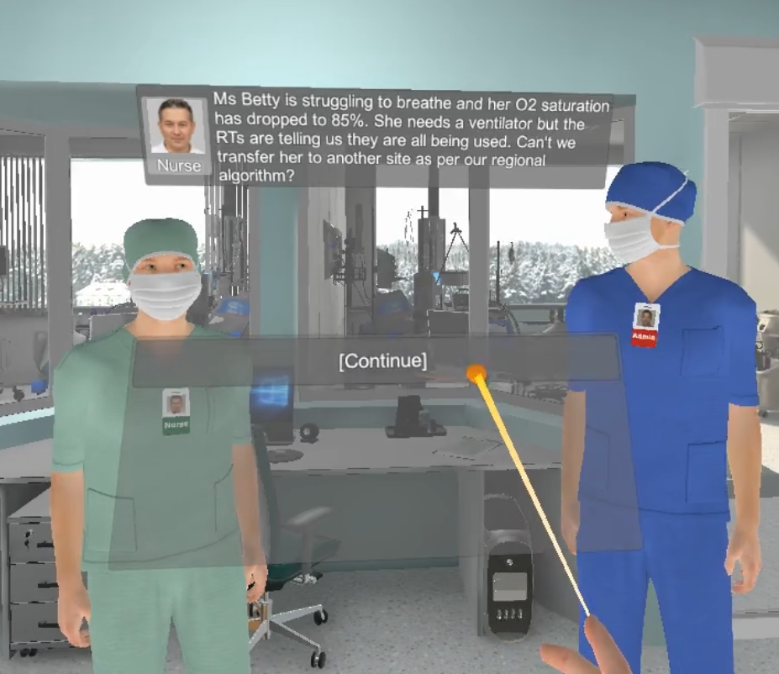
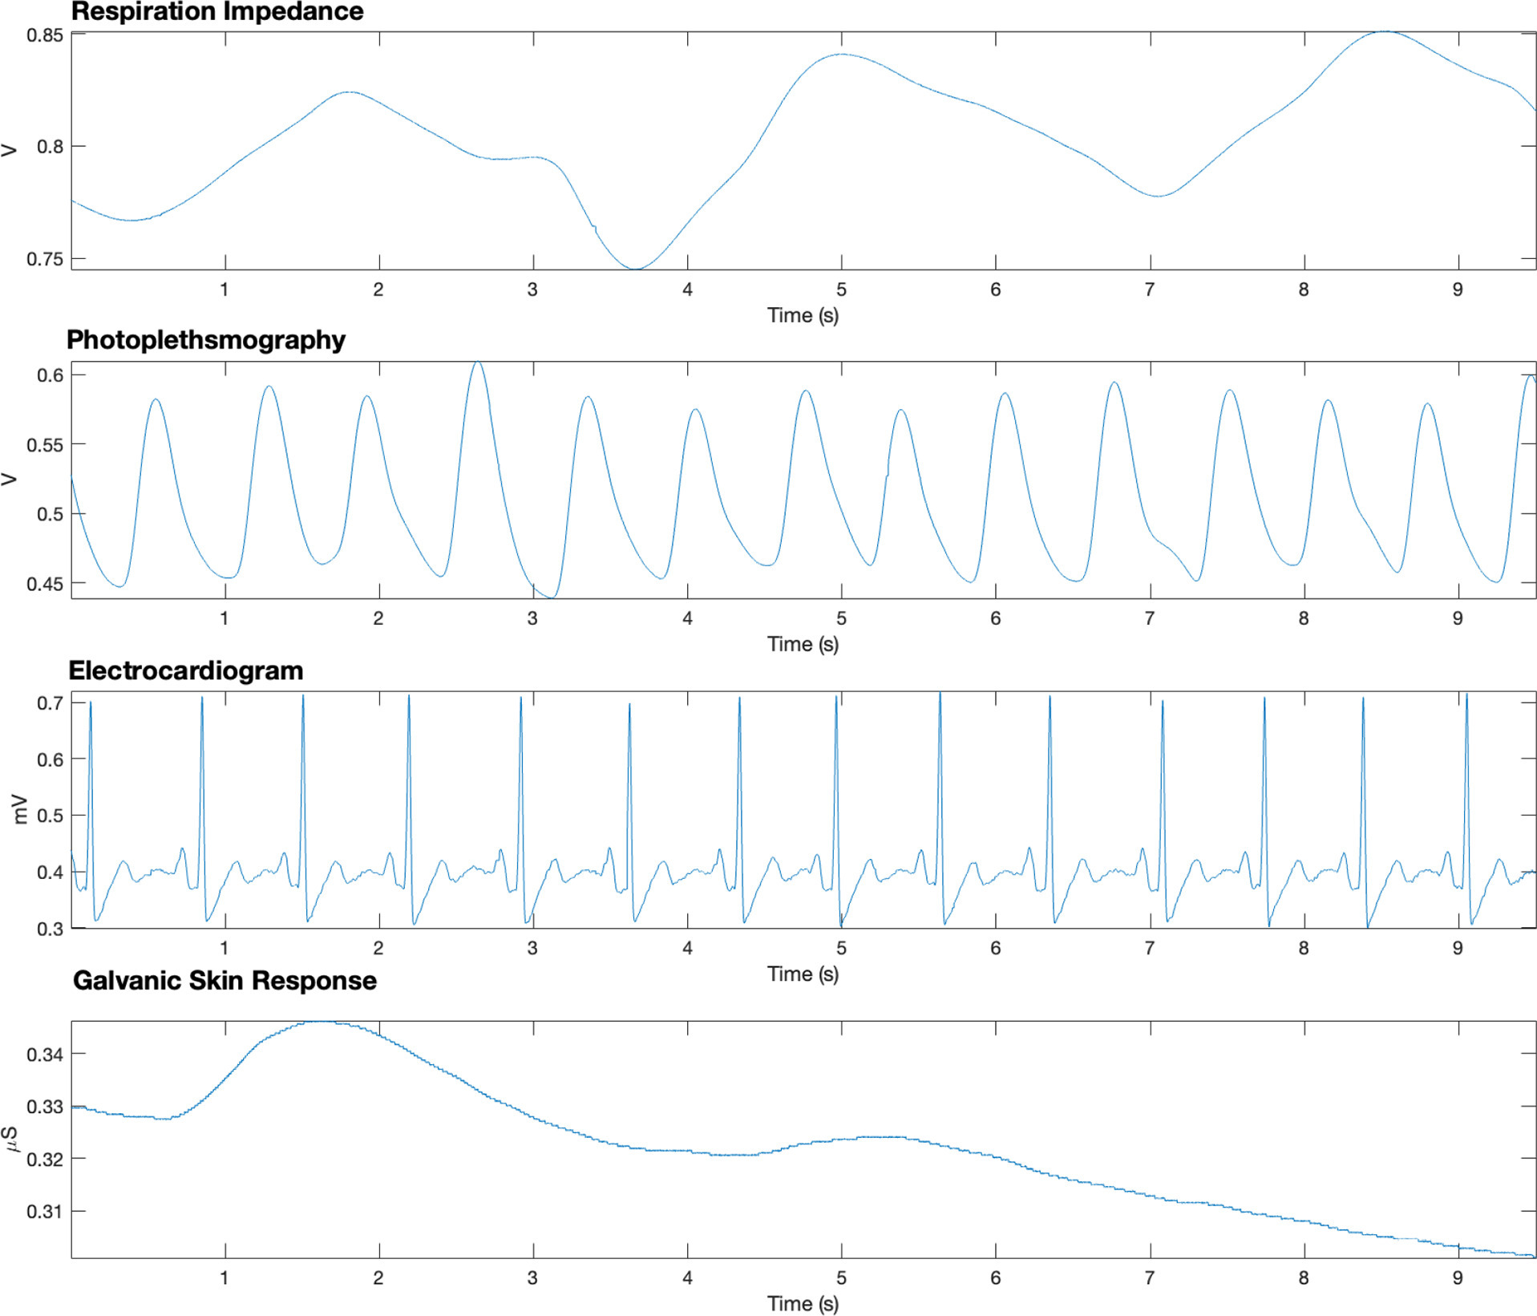
Objective
Understand moral distress through the use VR simulation to simulate the ICU during COVID-19
Use and evaluate potential digital interventions

Slide 4
Dataset
n=15 healthcare workers
Data collection involved
Passive physiological signals
Active mental health questionnaires
Notes:
Arrows describe the different places where active data is collected

Slide 5
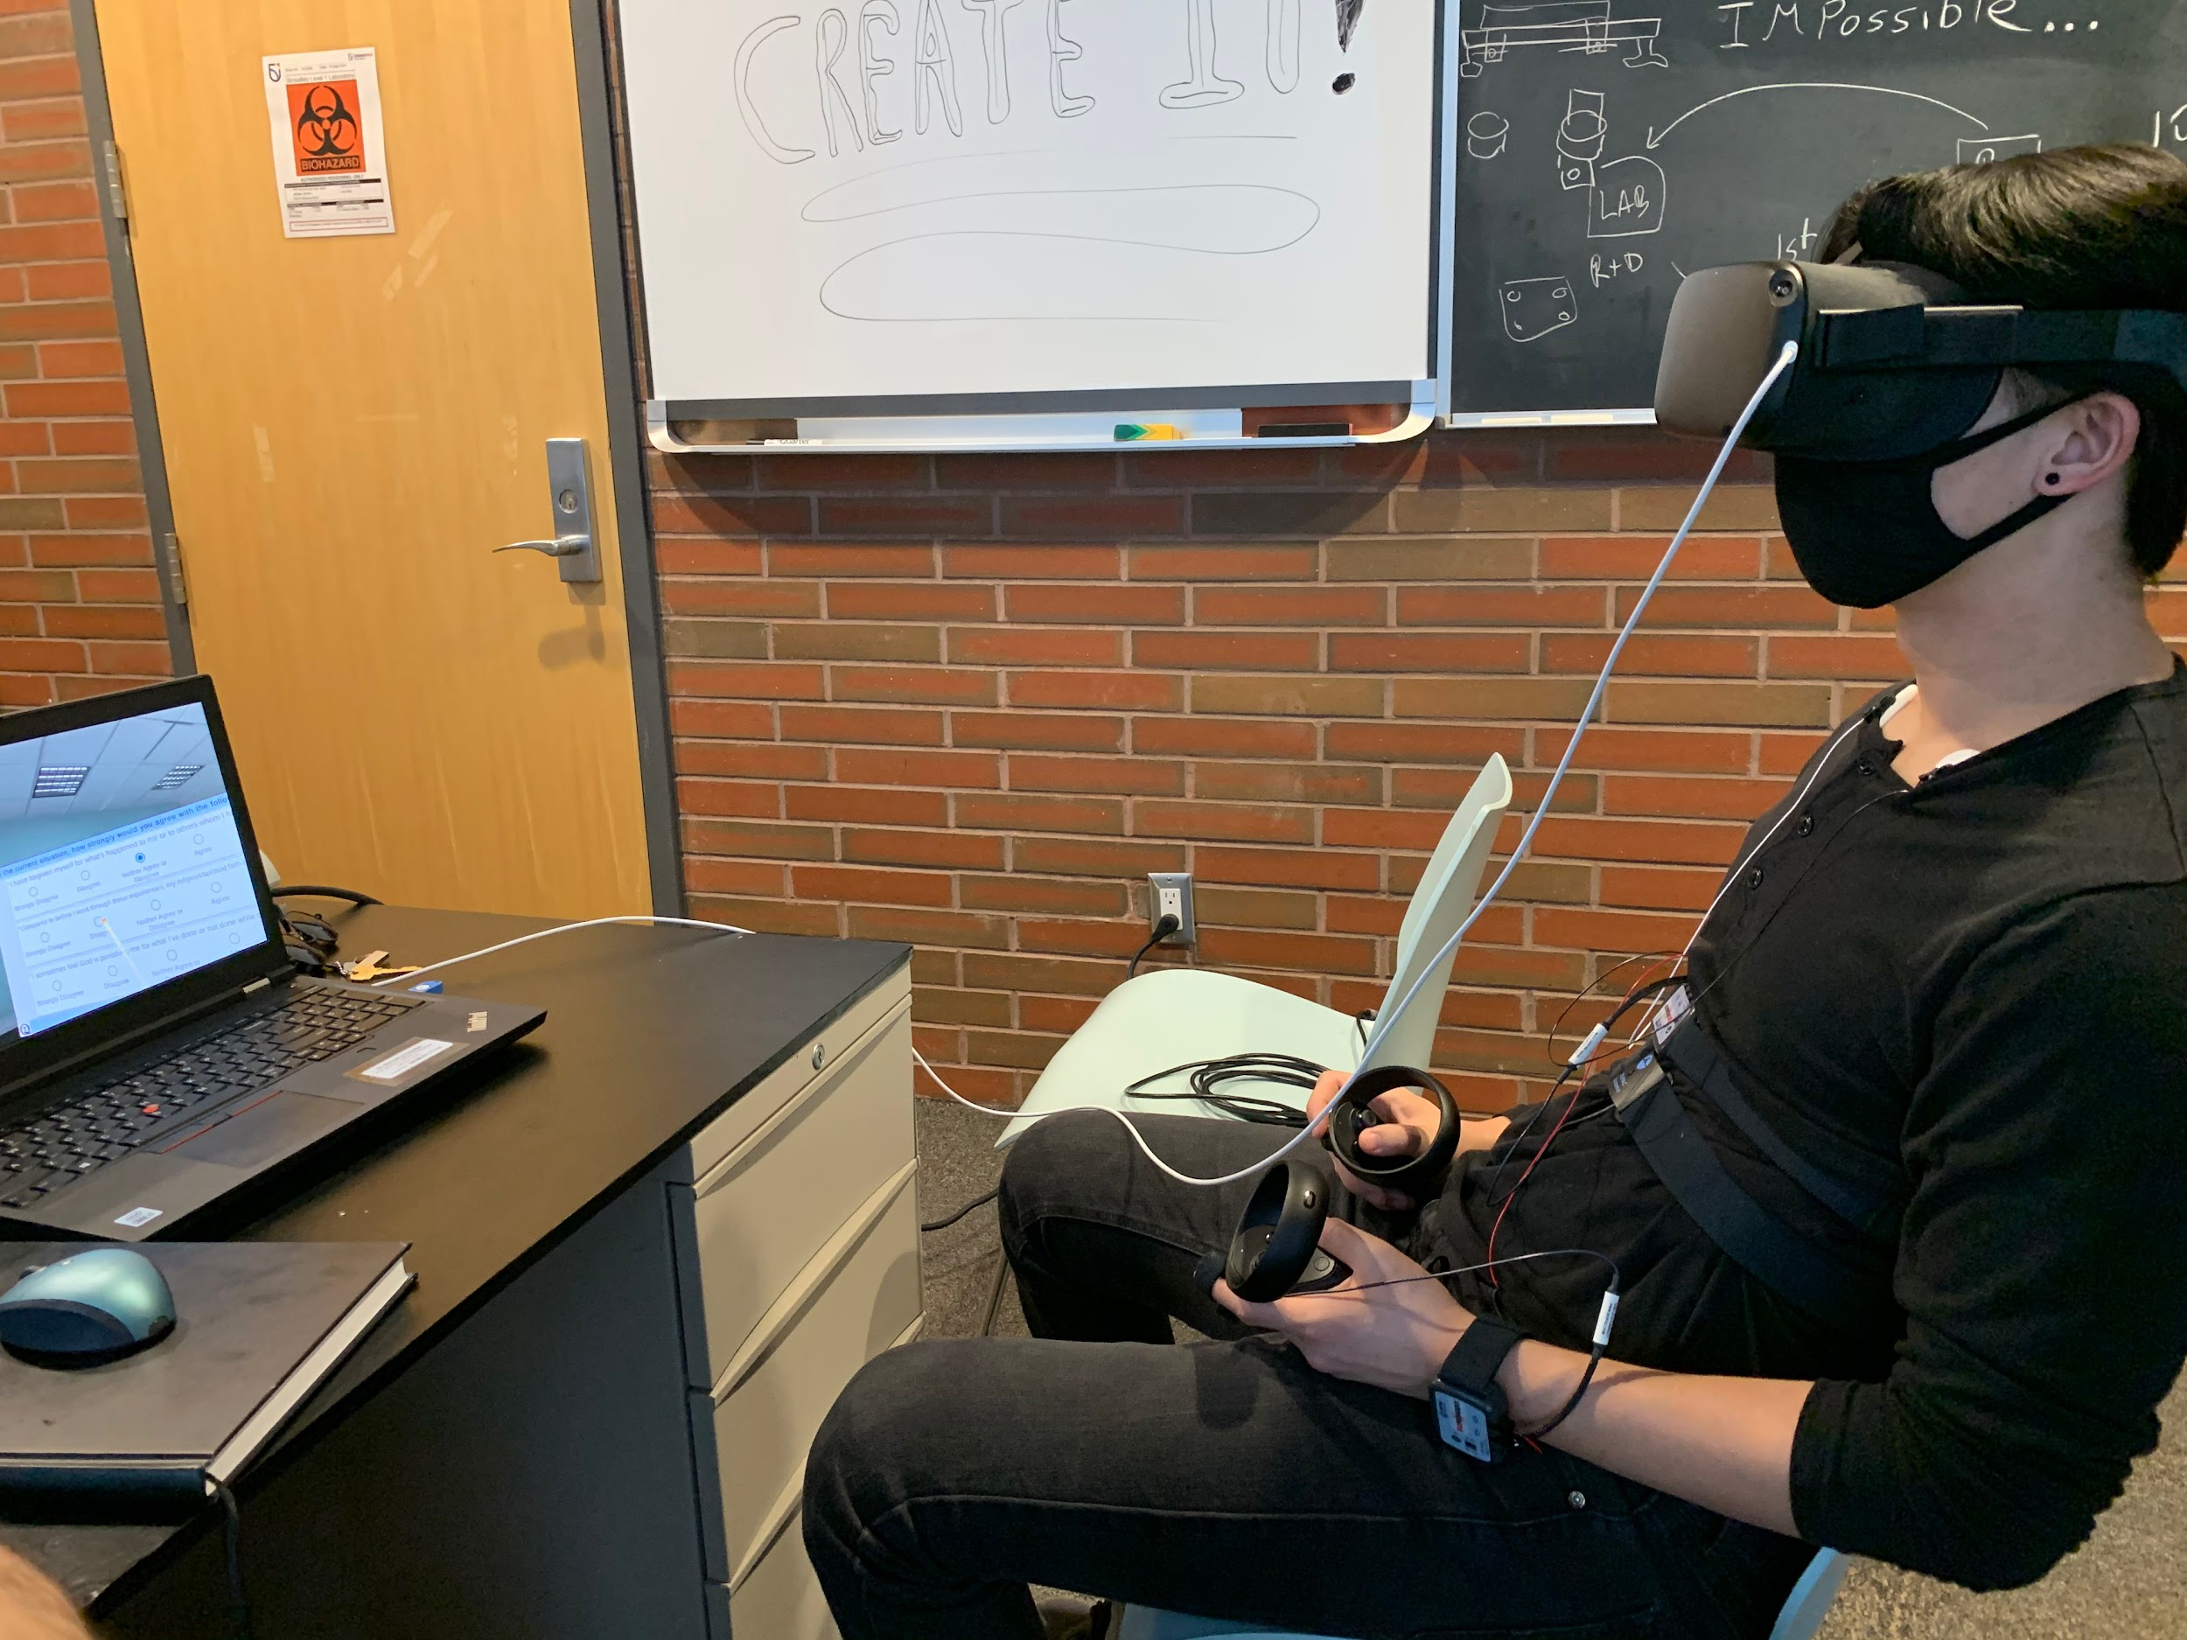
Dataset
VR
Simulation
Biopac
Respiration
Oxygen Saturation
Heart Rate
Skin conductance
Mental health questionnaire
Perceived Stress Scale (PSS)-10

Slide 6
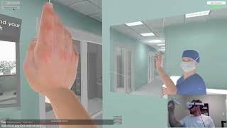
Notes:
https://www.youtube.com/watch?v=-mLzqPyHxXI&feature=youtu.be

Slide 7
Methods
Pre-processing
Feature extraction
Classification

Slide 8
Pre-processing
Segment 1 -
Physiological data
Normalization of data
Segmented the data
Windowing of 20 seconds
PSS-10
Clustered to low, moderate and high severity **
Segment 2 -
**The PSS-10 scale has a 0-40 range with diagnosis of low, moderate and high perceived stress for score ranges of 0-13, 14-26, and 27-40, respectively
Notes:
Windows were chosen for computational simplicity and empirical results showed that this achieved the best results

Slide 9
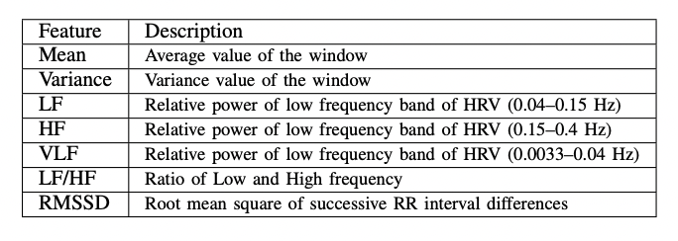
Feature Analysis
Notes:
Features that were extracted per window of the user

Slide 10
Classification and validation
Classification evaluated the separability between the PSS-10 severities among the users
SVM and DT
Synthetic Minority Oversampling Technique (SMOTE)
Weighted classification
Downsampling
Notes:
Stress is an underlying psychological disorder that requires intensive repetition to cause severe stress. Due to the limited time in the VR experiment, causing severe stress would not be ethical or achievable. Therefore, there may be an imbalance in the dataset. T

Slide 11
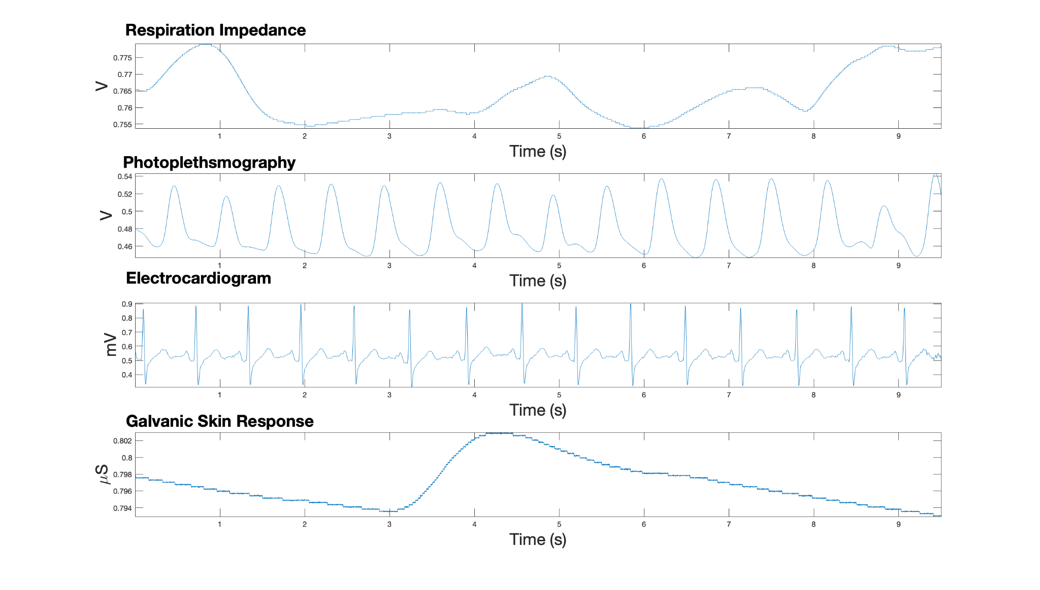
Results

Slide 12
Results
Collected n=15
Experimental length were an average of 47.12 with a variation of 6.41 minutes
The average length of Segment 1 and 2 were 22.16 and 24.96 minutes, respectively
A total of 2144 windows were created from 20-second windows

Slide 13
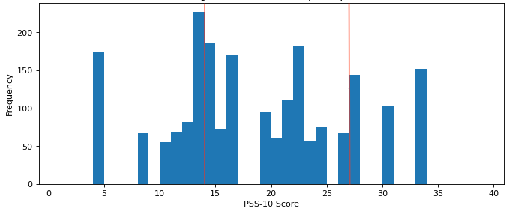
Notes:
This was the distribution of the PSS-10 scores prior to clustering and the red lines represent the cut off scores

Slide 14
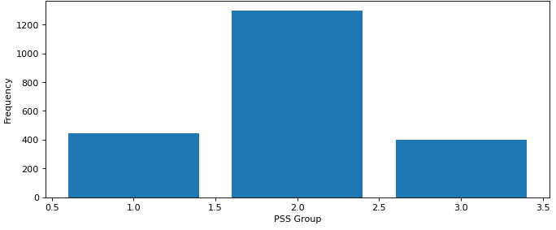
Notes:
This is the histogram of pss scores after clustering where cluster 1 2 3 represent low moderate and severe severiteis

Slide 15
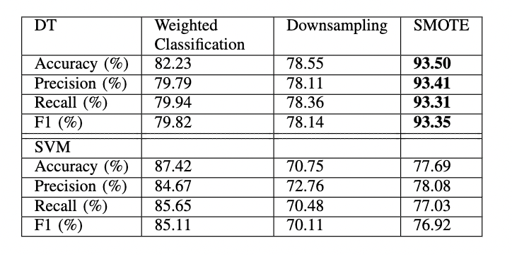
The weighted classification weights for class 1, 2, and 3 were 1.56, 0.55, and 1.79, respectively

Slide 16
Discussion and Conclusion
Our findings support literature to evaluate mental health through the use of physiological data
Advantages of using a low-complexity algorithm are that it allows for potential deployment on edge computing devices
Important to consider the potential limitations and ethical concerns such as data storage and analysis
Further research is needed to evaluate the performance of the algorithm in real-world settings

Slide 17
Contact us!
Binh Nguyen
Email: binh.nguyen@torontomu.ca
Twitter: @binhkimnguyen / @sar_research
LinkedIn: linkedin.com/in/binhnguyens

